Slide 1
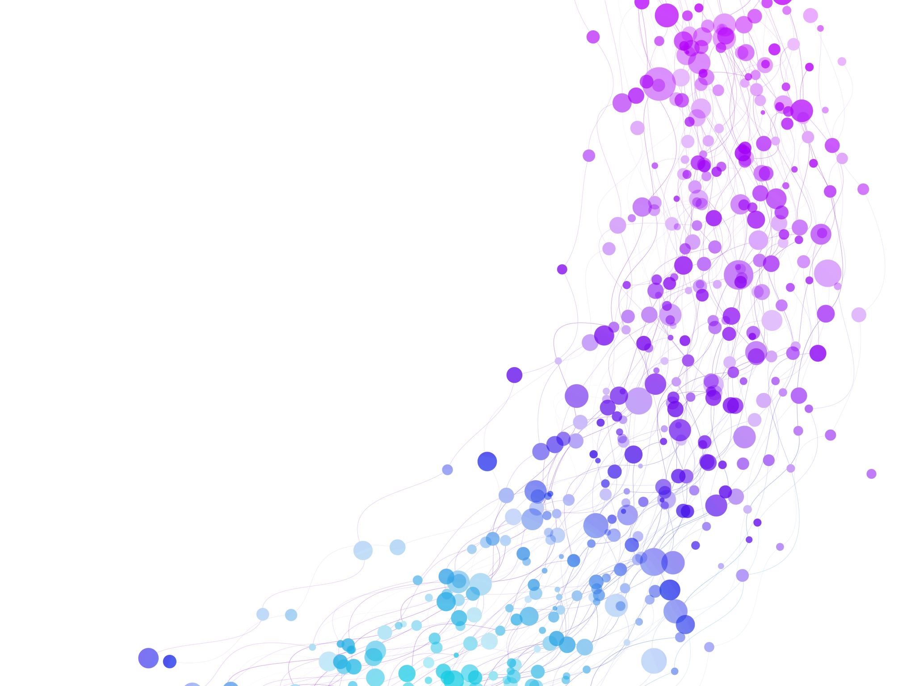

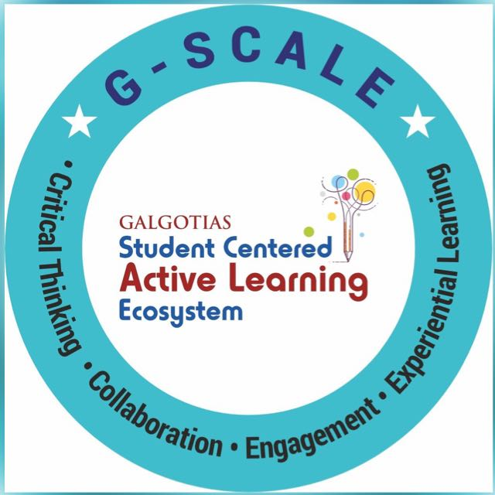
Natural Language Generation Session No.: 7 Course Name: Natural language processing Course Code: R1UC616C Instructor Name: Mr. Amit Yadav

Slide 2
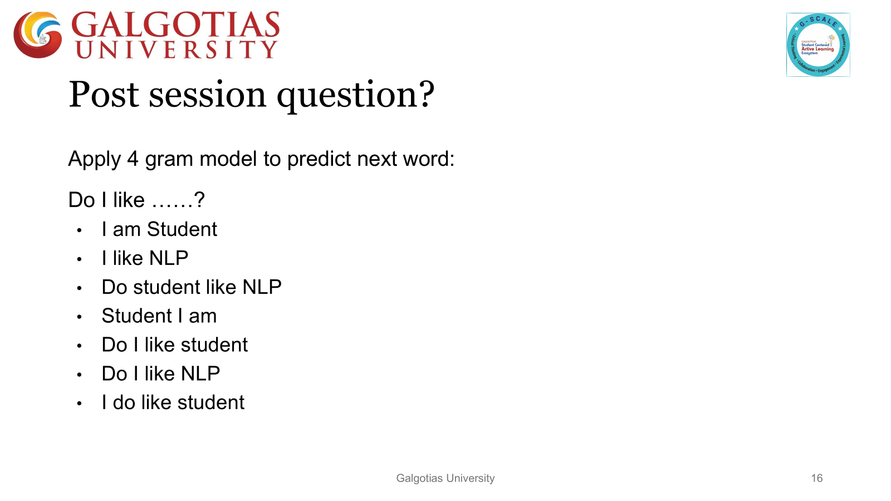
Reflect on the responses of post session activity

Slide 3


Ask Questions
Example for language
Difference between natural and other languages

Slide 4

open board discussion activity

Slide 5
English: A Germanic language spoken by millions worldwide.
Spanish: A Romance language widely spoken in Spain and Latin America.
French: Another Romance language, with a significant global presence.
German: A Germanic language spoken primarily in Germany, Austria, and Switzerland.
Hindi: An Indo-Aryan language spoken in India and parts of Pakistan.

Slide 6
At the end of this session students will be able to know
Explain the Fundamentals of NLG – Describe the key components, workflow, and importance of Natural Language Generation in NLP.
Analyze NLG Architectures and Techniques – Compare rule-based, template-based, statistical, and deep learning approaches used in NLG.

Slide 7
Session Outline
1 Definition of NL
2 Understanding language
3 Example for languages
4 How to use
5 class room activity

Slide 8
Two Components of NLP
Natural Language Understanding (NLU)
NLU helps the machine to understand and analyse human language by extracting the metadata from content such as concepts, entities, keywords, emotion, relations, and semantic roles.
NLU used in Business applications to understand the customer's problem in both spoken and written language.
NLU involves the following tasks –
It is used to map the given input into useful representation.
It is used to analyze different aspects of the language.
Natural Language Generation (NLG)
Natural Language Generation (NLG) acts as a translator that converts the computerized data into natural language representation.
It involves Text planning, Sentence planning, and Text Realization.

Slide 9
NLG definition and key components
NLG is a subfield of Natural Language Processing (NLP) that focuses on the automatic generation of human-like text from structured data.
Key components of NLG
Structured data such as tables, spreadsheets, databases, etc.(input)
Includes algorithms, templates, and models that process data to generate text.(system)
Natural language text that is understandable and coherent.(output)

Slide 10
Types of NLG Systems
Template-based NLG:
Uses predefined sentence structures and templates to generate text.
Example: Weather reports.
Rule-based NLG:
Uses rules and linguistic patterns to generate text from data.
Example: Financial reports.
Deep Learning-based NLG:
Uses deep learning models (like GPT, T5) trained on large datasets to generate text.
Example: Chatbots, content generation.

Slide 11
APPLICATIONS
Business and Finance:
Automating financial reports, earnings summaries, and business analytics.
Healthcare:
Generating medical reports, patient summaries, and research papers.
Customer Service:
Chatbots and virtual assistants for automated customer support.
Content Creation:
Automatically generating blog posts, news articles, and social media content.
Weather Forecasting:
Automated generation of weather reports from meteorological data.

Slide 12
Advantages of NLG
Time-saving: Automates repetitive text creation tasks.
Scalability: Can generate large volumes of content quickly.
Consistency: Provides uniform language output without human error.
Cost-effective: Reduces the need for manual labor in content generation.

Slide 13
Challenges in NLG
1.Context Understanding:
Ensuring the generated text is contextually accurate.
2.Coherence and Fluency:
Ensuring the generated text sounds natural and is easy to read.
3.Data Quality:
Poor or incomplete data can lead to nonsensical outputs.
4.Bias and Ethics:
Ensuring that generated text is unbiased and ethical.

Slide 14
Future of NLG
Advancements in AI:
As AI models improve, NLG systems will generate more sophisticated and human-like text.
Personalization:
Tailored content based on user preferences and past behavior.
Integration with other AI Systems:
NLG will become more integrated with other AI tools (like speech recognition, sentiment analysis, etc.) to provide richer experiences.

Slide 15
Difference: NLG vs NLP
NLP (Natural Language Processing) – Analyzes and understands human language.
NLG (Natural Language Generation) – Focuses on creating human-like text.
NLP is input-focused (processing text), whereas NLG is output-focused (generating text).

Slide 16
NLG Workflow
Content Determination - Selecting relevant information.
Text Structuring - Organizing information logically.
Sentence Planning - Choosing appropriate words and syntax.
Lexicalization - Assigning words to concepts.
Surface Realization - Generating final text output.

Slide 17
CLASSROOM ACTIVITY
Character | Location | Event | Date
John | Park | Lost wallet | February 15
Sarah | Mall | Found a cat | February 16
Mike | Library | Won a prize | February 17
The groups need to use the provided data to build a coherent story. They should imagine that they are a Natural Language Generation system, and they need to create a narrative based on the structured data.
Decide the context, style, and tone of the story. They might write a short story, a news article, or even a diary entry, incorporating all the facts in a creative way.

Slide 18
Error Analysis in NLG Outputs (Critical Thinking & Evaluation)
"The temperature is hot, and the rain is dry."
Identify issues (e.g., logical errors, grammar mistakes). Suggest improvements.

Slide 19
Error Analysis in NLG (Critical Thinking & Evaluation)
Identify issues (e.g., logical errors, grammar mistakes). Suggest improvements.
"The temperature is hot, and the rain is dry.“
"The temperature is high, and there is no rain."

Slide 20

Review and Reflection from students
Participation link
HSLBCT
https://app.wooclap.com/HSLBCT?from=instruction-slide

